Slide 1


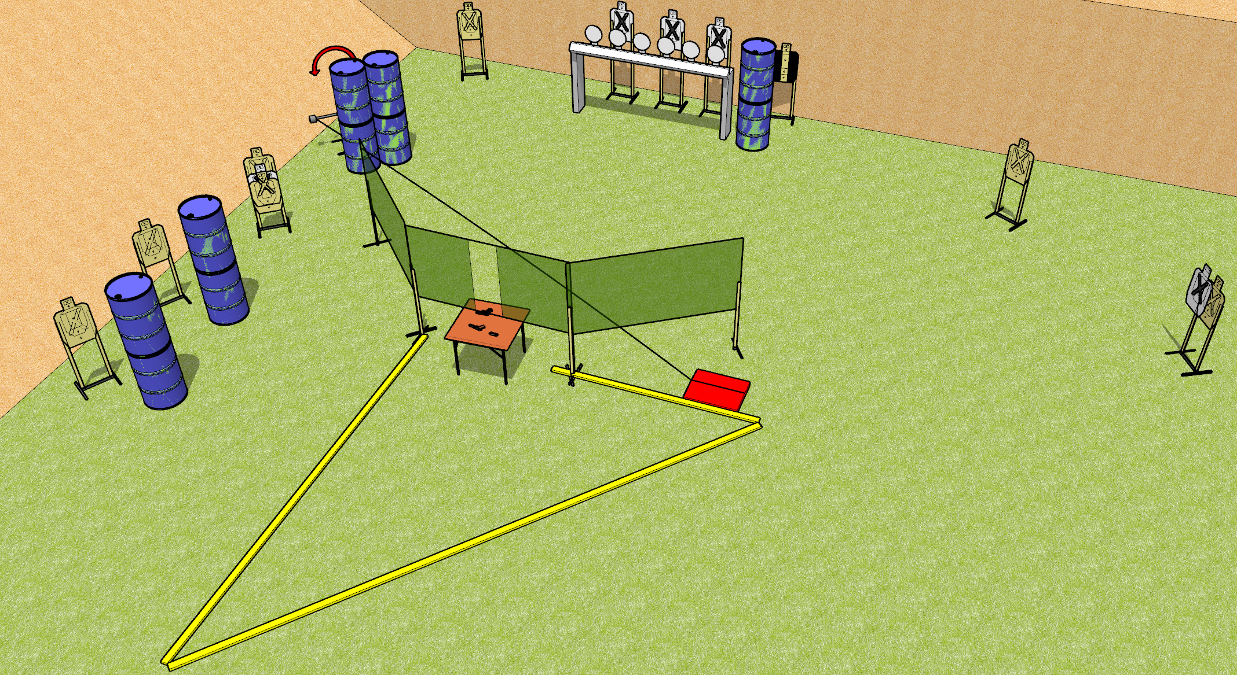
 | Dothan Gun Club – USPSA Match Hanging Around Course Designer : Drew Coleman
START POSITION : Standing anywhere completely outside the shooting area. Hands relaxed at sides.
GUN READY CONDITION : Pistol/PCC unloaded placed on table with trigger guard touching mark, muzzle perpendicular to the back berm. |  | SCORING: Comstock, X rounds TARGETS: 9 paper, 6 Steel SCORED HITS: Best 2 on paper, steel until down START-STOP: Audible, last shot RULES: All magazines must come from the table.
STAGE PROCEDURE: Engage targets as they become available from within the fault lines

